Slide 1
Dare to Teach APL!
Aaron W. Hsu
Indiana University

Slide 2
Warning!
All results, statistics, and discussion of this project and in this presentation are extremely preliminary and should be understood in this context.

Slide 3
What happens when…
You let them pick what they want to do, and you only teach them how to program in parallel, purely functionally, with none other than APL dfns?

Slide 4
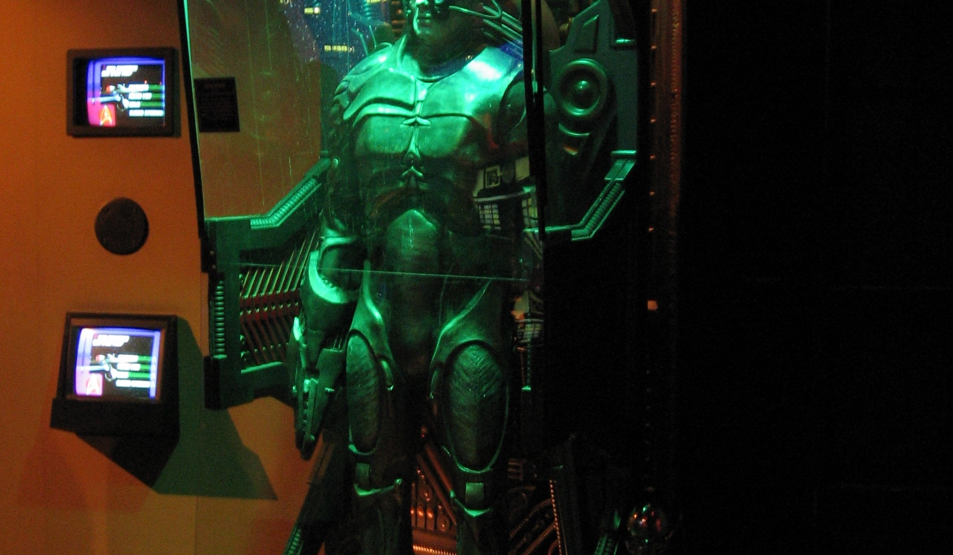
Resistance is futile

Slide 5
What is FSM?
Foundations in Science and Mathematics
AKA: Flying Spaghetti Monster, Finite State Machine

Slide 6
The FSM was an opportunity to create a completely original, ground-up re-envisioning of Computer Science Education:
How does syntax/semantics affect student learning?
What does it look like for students to know naught but parallel programming?
APL (dfns) uniquely suited to such a study.

Slide 7
Can we funnel new talent into the University System?
We emphasized Women in Computing initiatives and targeted IU’s Scheme-based, functional style curriculum for “future looking” plans.

Slide 8
Major People Involved
Aaron W. Hsu (APLer, Schemer, masochist willing to mention APL to the faculty)
Jason Hemann (Apprenticed to Dan Friedman)
Jennie Lipson (IU Undergraduate Instructor for entry-level courses)
Anna Eilering (Pre-course preparation, information, and Robot obsessed)

Slide 9
How do you handle enrollment?

Slide 10
Students are self selected, but the Computer Science course was opt-out rather than opt-in.
Enrollment strategies designed to compensate for traditional selection bias.

Slide 11
Our educational framework is clumsily and sloppily based on concepts appearing in Educational Research, including situated learning and constructivist techniques.
Put in NP speak, this means that we tried to make the work they did relevant and self-motivated based on their own interests and “context.”
We used little formal lecture and no linear curriculum for the design.

Slide 12
Course Structure
Domains
Apl, Reference Materials
Math
Physics
Biology
Chemistry
Image Manipulation
Whatever ya want, kid…
Mastering Dyalog APL (sort of)
Custom “Guide”
Glossary of terms
Emphasized declarative programming
Dyalog APL on RHEL Workstations
Full environment, no special aids

Slide 13
Do what you like

Slide 14
Work on real problems

Slide 15
Just code, socially

Slide 16
Declarative Functional Parallel

Slide 17
We achieved significant minority enrollment
More than 1/3 were women
Enrollment process actively contributed to these #’s

Slide 18
What we were worried about…
Symbols, symbols, symbols…
Console programming in the Linux environment
Slow, boring progress, lack of demonstrated interest in domains
Symbols, symbols, symbols…

Slide 19
Students had zero tangible difficulties with APL symbols!
This was one of the most unexpected anecdotal experiences we had.

Slide 20
Every class had at least one student in each domain

Slide 21
There appears to be little to no additional difficulty for parallel programming
While anecdotal, students were able to successfully accomplish a significant amount of work using nothing but pure functional, parallel programming.

Slide 22
While unsurprising, it is still disappointing to see that students appear to completely forget everything they ever learned, ever, when they enter the APL Session.

Slide 23
This was an “unexpected” success
We encountered significant opposition to the use of APL
A few of the students are regular participants in the IU computing groups
A surprising number of students were able to complete more than one domain’s worth of work
Students by and large had fun, were engaged, and participated successfully in traditionally valuable Computer Science “norms”

Slide 24
Write your own code
Unlike many approaches to high school C.S. we did not give them much code, and they wrote all of the code for their solutions, with almost zero scaffolding.

Slide 25
Example Problems
Fractals
Blurring an animation repeatedly as an animation
Plotting the trajectory of a cannon ball
Developing a colorized version of the Game of Life
Writing a sprite oriented RPG game engine (Rogue-like)
A host of custom image manipulations designed by students

Slide 26
Parallel programming has been mistaught

Slide 27
APL allowed us to expose students to a surprisingly wide variety of relatively advanced Computer Science concepts in the time it takes most classes to get to defining your first helper function.
The exposure was intentionally shallow but broad.
Students actually enjoyed themselves, usually.

Slide 28
Future Work
Do these same techniques work differently if we use a different language?
Does this scale to a longer course?
Can we obtain any quantitative results?
How well can students transition into a traditional program?
Analysis of recorded screen sessions

Slide 29
Thank you
Questions eagerly awaited….

